Slide 1
CREDIT CARD FRAUD DETECTION
Under the Guidance of Assistant Prof….

Slide 2
Abstract
Today, all around the world data is available very easily. This information comes from tons of sources like social media followers, likes and comments.
All this information used for analysis and visualization of the hidden data pattern.
For frauds, the credit card is an easy and friendly target because without any risk a significant amount of money is obtained within a short period.
Fraudsters try to make every fraudulent transaction legitimate which makes fraud detection a challenging problem.

Slide 3
Introduction
For frauds, the credit card is an easy and friendly target because without any risk a significant amount of money is obtained within a short period.
Credit card dataset is highly imbalanced dataset because it carries more legitimate transactions as compared to the fraudulent one.
To handle this kind of problem one better way is to class distribution, i.e., sampling minority classes.
In sampling minority, class training example can be increased in proportion the majority class to raise the chance of correct prediction by the algorithm like decision tree and random forest algorithms.

Slide 4
Literature Survey
In this research, “A Novel Approach for Credit Card Fraud Detection” is designed . To stop these fallacious transactions a technique is designed which uses the Behavior Based Technique.
Implementation of Novel Approach for Credit Card Fraud Detection.
Firstly, Shopping Behavior is based on which type of products customer buys. Secondly, Spending Behavior in this the fraud is detected based on the maximum amount spent.
Finally average is taken out by summing the result.

Slide 5
Literature Survey
Credit card fraud detection, which is a data mining problem, becomes challenging due to two major reasons – first, the profiles of normal and fraudulent behaviors change constantly and secondly, credit card fraud data sets are highly skewed.
The performance of fraud detection in credit card transactions is greatly affected by the sampling approach on dataset, selection of variables and detection technique(s) used.
The work is implemented in Python. The performance of the techniques is evaluated based on accuracy, sensitivity, specificity, precision.

Slide 6
Existing System
In general, credit card fraud detection has been known as the process of identifying whether transactions are genuine or fraudulent.
As the data mining and machine learning techniques are vastly used to counter cyber-criminal cases.
While data mining focused on discovering valuable intelligence, machine learning is rooted in learning the intelligence and developing its own model for the purpose of classification, clustering or so on.

Slide 7
Disadvantages of Existing System
Imbalanced data
Overlapping data
Lack of adaptability
Fraud detection cost.
Lack of standard metrics

Slide 8
Proposed system
Our proposed system applies supervised machine learning algorithms to detect credit card fraudulent transactions using a real-world dataset.
Furthermore, we employ these algorithms to implement a classifier using machine learning methods.
We identify the most important variables that may lead to higher accuracy in credit card fraudulent transaction detection.

Slide 9
Advantages of Proposed System
More accurate result.
Able to detect different fraudulent behavior.
Cost and Time efficient.

Slide 10
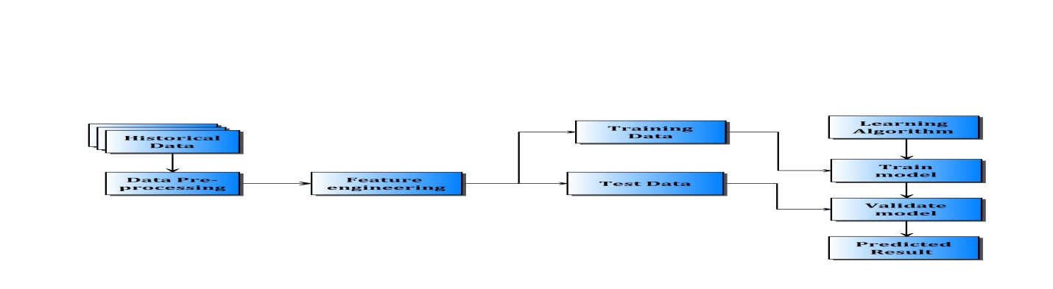
Design(System Architecture)
Fig. System Architecture

Slide 11
Design(System Architecture)
System Architecture design-identifies the overall hypermedia structure for the WebApp.
Architecture design is tied to the goals establish for a WebApp, the content to be presented, the users who will visit, and the navigation philosophy that has been established.
Content architecture, focuses on the manner in which content objects and structured for presentation and navigation.
WebApp architecture, addresses the manner in which the application is structure to manage user interaction, handle internal processing tasks, effect navigation, and present content.

Slide 12
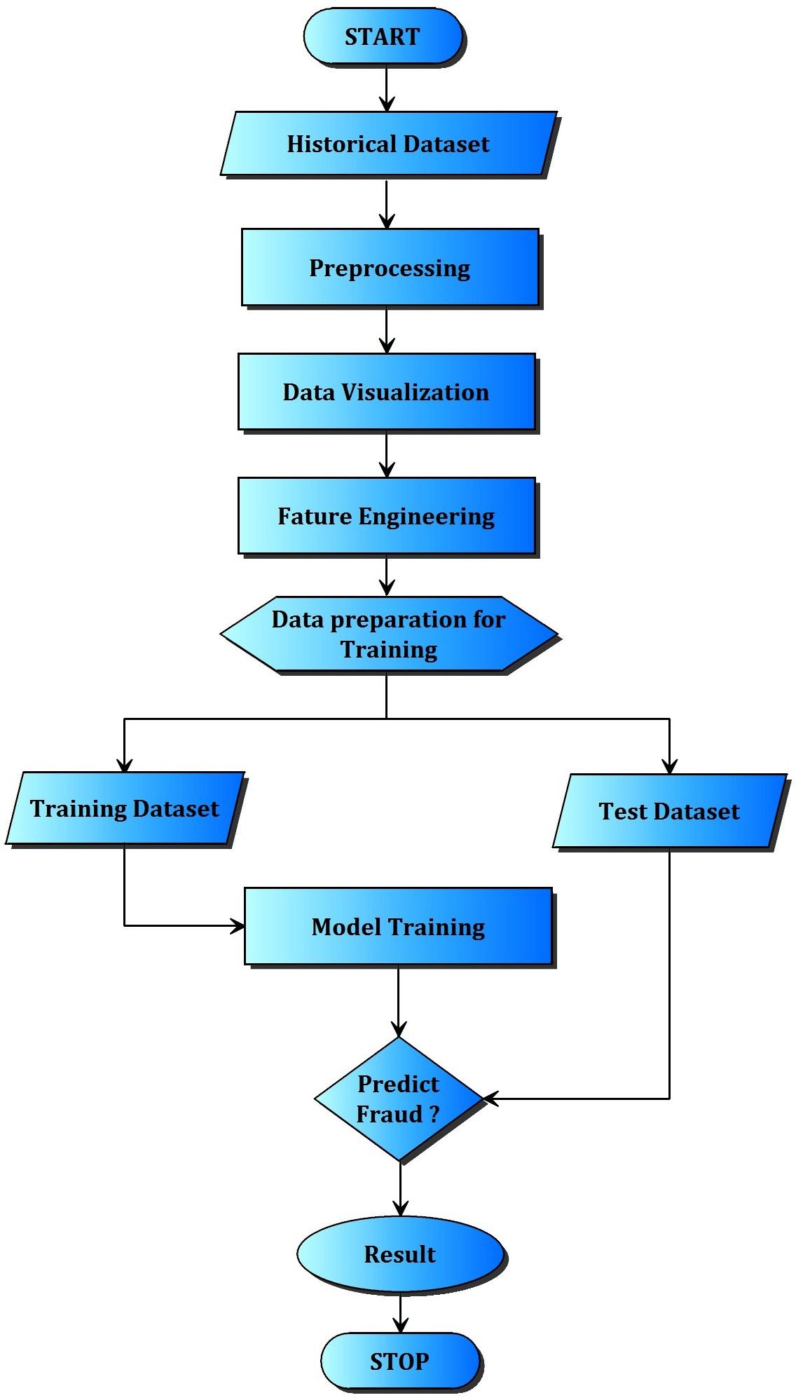
Flow Diagrams

Slide 13
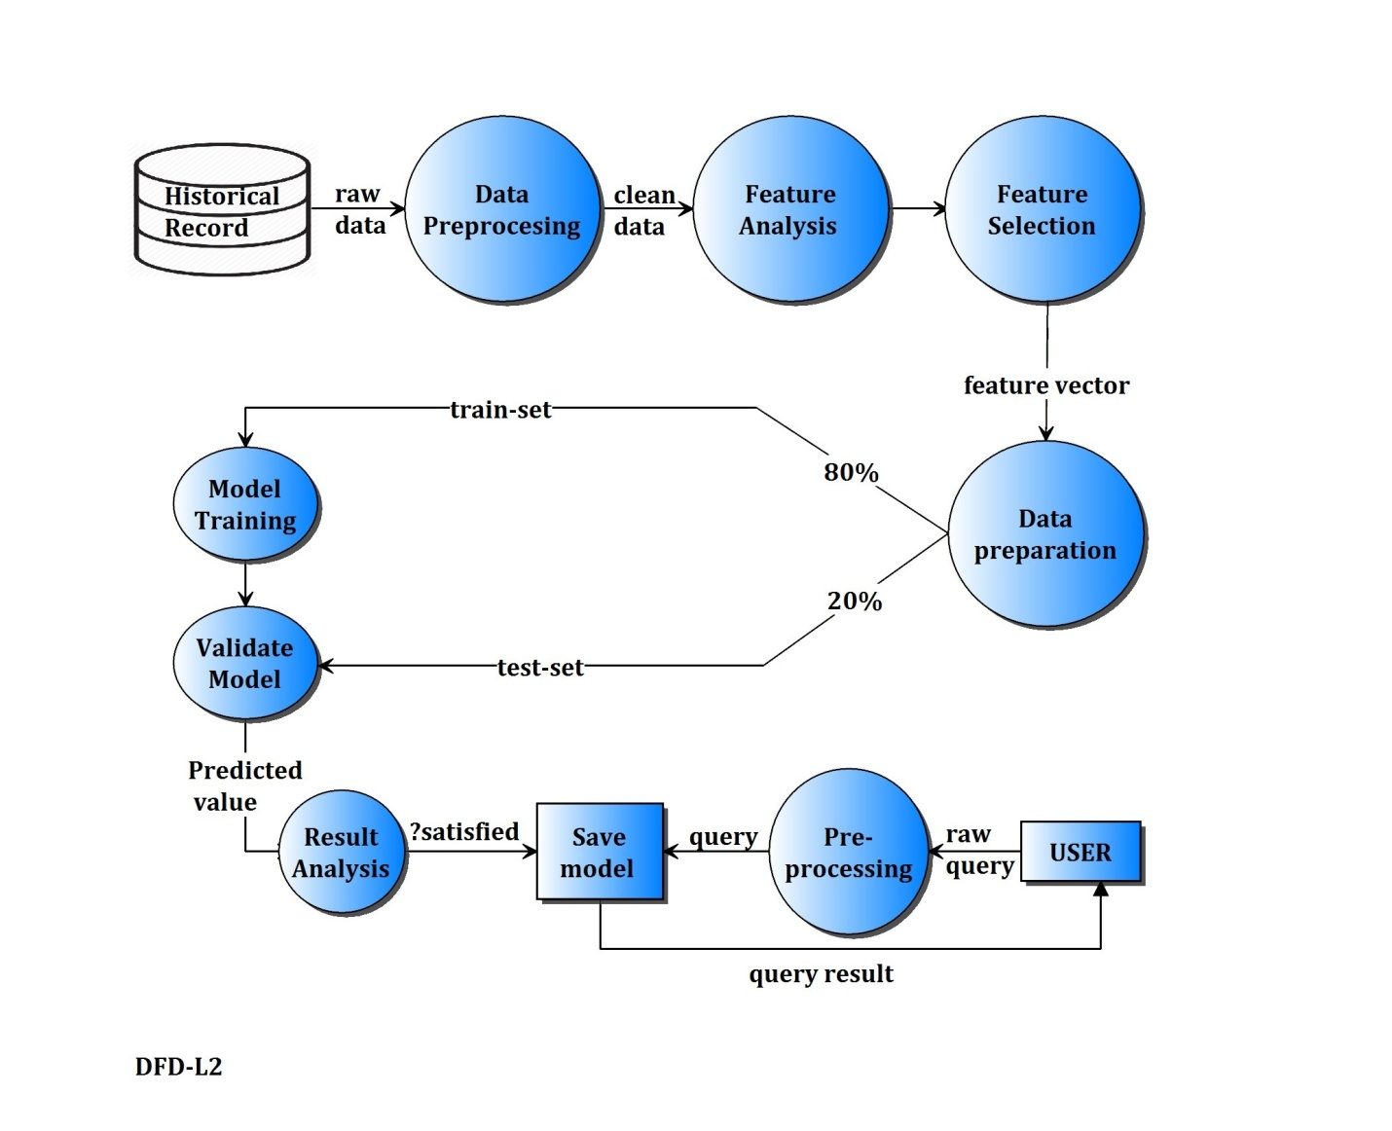
Flow Diagrams

Slide 14
Implementation
Python is an easy to learn, powerful programming language. .
The Python interpreter and the extensive standard library are freely available in source or binary form for all major platforms .
Decision tree:
Decision Tree algorithm belongs to the family of supervised learning algorithms. Unlike other supervised learning algorithms, decision tree algorithm can be used for solving regression and classification problems too.
The general motive of using Decision Tree is to create a training model which can use to predict class or value of target variables by learning decision rule inferred from prior data(training data).

Slide 15
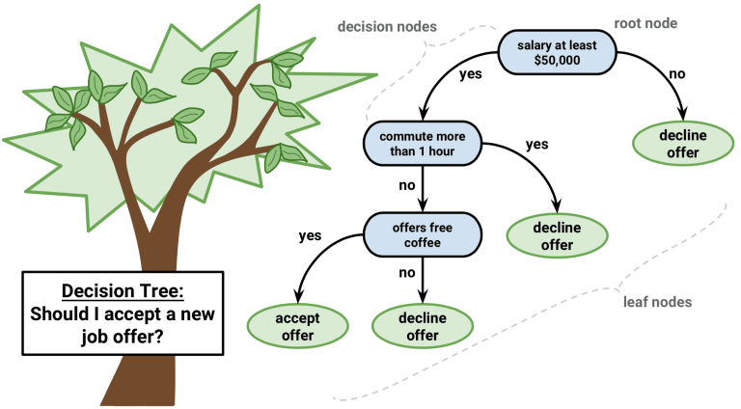
Implementation
Decision Tree Algorithm Pseudocode
Place the best attribute of the dataset at the root of the tree.
Split the training set into subsets. Subsets should be made in such a way that each subset contains data with the same value for an attribute.
Repeat step 1 and step 2 on each subset until you find leaf nodes in all the branches of the tree.

Slide 16
Implementation
Random Forest
Random Forest Classifier being ensemble algorithm tends to give more accurate result.
This is because it works on principle, Number of weak estimators when combined forms strong estimator.
Even if one or few decision trees are prone to a noise, overall result would tend to be correct. Even with small number of estimators = 30 it gave us high accuracy as 97%.

Slide 17
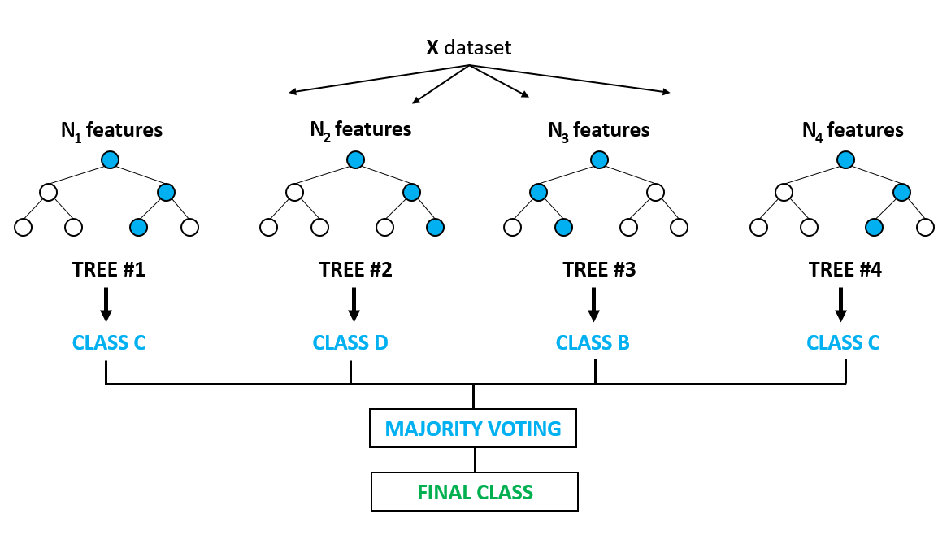
Implementation

Slide 18
Results
On Fetching the performance of the Machine Learning Model over given test data we found nearly 77% accuracy with increased number of datasets by which the accuracy of the model and performance can be increased to a greater level.
When compared between model performance between decision tree and random forest algorithms, it is found that random forest has more accuracy than model developed based on decision tree algorithm.
As Random Forest Algorithm takes the aggregate of random decision tree outputs, it has a greater chance of perfect predictions than single tree.

Slide 19
Results

Slide 20
Conclusion and Future Scope
This system is capable of providing most of the essential features required to detect fraudulent and legitimate transactions.
As technology changes, it becomes difficult to track the behavior and pattern of fraudulent transactions.
We have just detected the fraudulent activity but we have not prevented. Preventing known and unknown fraud in real time is not easy but it is feasible.
The dataset available on day to day processing may become outdated, it is necessary to have updated data for effective fraud behavior identification.

Slide 21
Conclusion and Future Scope
Fraudster uses different new techniques that are instantaneously growing along with new technology makes it difficult for detection.
Also the nature of access pattern may vary from one geographical location 161 to another (such as urban and rural areas) that may result in a false positive detection.
In such a case a future enhancement may be based on new multiple models with varying access pattern needs attention to improve the effectiveness.

Slide 22
Requirements
The system should be developed using Python Programming on Anaconda Framework in Windows Operating System.
Once user format. can able to upload credit card fraud dataset in .xls file

Slide 23
References
[1] S. Bhattacharyya, S. Jha, K. Tharakunnel, and J. C. Westland, “Data mining for credit
card fraud: A comparative study,” Decis. Support Syst., vol. 50, no. 3, pp. 602–613, 2011.
[2] K. Chaudhary, J. Yadav, and B. Mallick, “A review of Fraud Detection Techniques:
Credit Card,” Int. J. Comput. Appl., vol. 45, no. 1, pp. 975–8887, 2012.
[3] “Mining of Massive Datasets Second Edition.”
[4] F. N. Ogwueleka, “Data Mining Application in Credit Card Fraud Detection System,” vol. 6, no. 3, pp. 311–322, 2011.
[5] H. Nordberg, K. Bhatia, K. Wang, and Z. Wang, “BioPig: a Hadoop-based analytic toolkit for large-scale sequence data,”Bioinformatics, vol. 29, no. 23, pp. 3014– 3019, Dec. 2013.

Slide 24
References
[6] M. Hegazy, A. Madian, and M. Ragaie, “Enhanced Fraud Miner: Credit Card Fraud
Detection using Clustering Data Mining Techniques,” Egypt. Comput. Sci., no. 03, pp. 72–81, 2016.
[7] M. Zareapoor and P. Shamsolmoali, “Application of credit card fraud detection:
Based on bagging ensemble classifier,” Procedia Comput. Sci., vol. 48, no. C, pp.
679–686, 2015.
[8] O. S. Yee, S. Sagadevan, N. Hashimah, and A. Hassain, “Credit Card Fraud Detection
Using Machine Learning As Data Mining Technique,” vol. 10, no. 1, pp. 23–27.
[9] K. Randhawa, C. K. Loo, M. Seera, C. P. Lim, and A. K. Nandi, “Credit Card Fraud
Detection Using AdaBoost and Majority Voting,” IEEE Access, vol. 6, pp. 14277–14284, 2018.
[10] N. Mahmoudi and E. Duman, “Detecting credit card fraud by Modified Fisher Discriminant Analysis,” Expert Syst. Appl., vol. 42, no. 5, pp. 2510–2516, 2015.

Slide 25
Thank you

